Slide 1


Requirements Specification
Lambert Air Management System
Authors: Josh Snider, Matthew Lavin and Andrew Daur
Professor: Dr. Elvis Foster
Class: CS 440

Slide 2
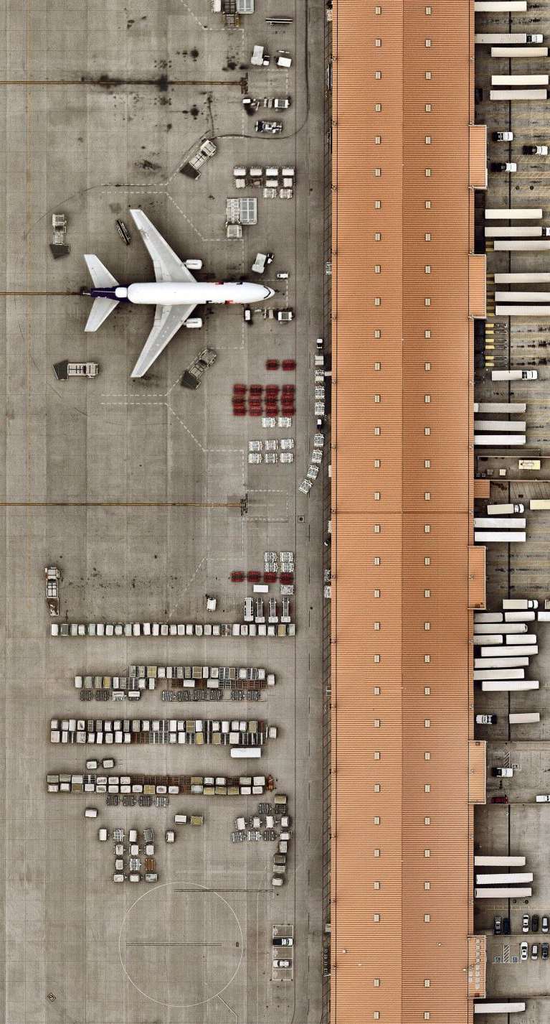
Problem
Flight traffic has more than doubled in the last two decades
Airport management is a highly dynamic job with strict requirements for efficiency
Limited number of runways, gates, and terminals must serve flight volume

Slide 3
Increase in flight traffic
Notes:
Here is the diagram provided by the World Bank. It illustrates the dramatic increase since 1995, putting higher demand on airports that can’t expand their infrastructure. Recent volatility means data is needed for business decisions, not just guesswork.

Slide 4
Solution
Flight Management System developed from scratch
Easy data entry and decision-making for staff, modern data output for customers
Proven software means deployment at any airport
Standard object-oriented language
MySQL/MariaDB for data storage
Information processing broken into subsystems
Port Information Subsystem
Airline & Aircraft Information Subsystem
Flight Information Subsystem
Produce multiple business benefits:
Modernized, integrated software solution streamlines all aspects of airport logistics
Increased throughput and efficiency increases airport, airline revenue
Communication between connected airports on a shared software platform.

Slide 5
Object Flow Diagram
Relational Database (MySQL)
Port Information Subsystem
Arrival/Departure Subsystem
Aircraft & Airline Subsystem

Slide 6
Information Topology Chart
Flight Management System
Aircraft & Airline Subsystem
Airport
Aircraft
Aircraft Category
Airline
Terminal
Gate
Runway
Country
Port Information Subsystem
Arrival/Departure Subsystem
Flight Crew
Flight Crew
Flights
Flight Schedules

Slide 7
Storage Requirements
Entity Name & ID | Primary Key Attribute | Notes (optional)
Countries (E01) | Country Code : CnCode | To give location of a port or airline.
Participating Ports (E02) | Participating Ports Code: PortCnCode | For defining information about participating ports.
Airlines (E03) | Airlines Code: AlCode | Identification for all airlines
Aircrafts (E04) | Aircrafts Code: AcCode | Information regarding individual aircraft
Runways (E05) | Runways Code: RwPortCode | Entity to keep track of all runways as child of hosting port, with runway dimensions
Terminals (E06) | Terminal Code: TCode | Entity to keep track of all terminals and associated port, complete with terminal status
Gates (E07) | Gate Code: GCode | Stores gates information, including associated port and status.
Flight Officials (E08) | Flight Officials Code: OCode | Keeps track of all airline staff related to flights and which airline that employs them.
Flights (E09) | Flights Code: FNumber | Information on a recurring scheduled flight
Arrival/Departure Schedule (E10) | Arrival/Departure Schedule Code: FNumber, FDate | Information on a single arriving or departing flight that has a corresponding regularly scheduled flight.
Aircraft Types (E11) | Aircraft Types Code: AcTypeCD | Keyed by respective IATA type designators

Slide 8
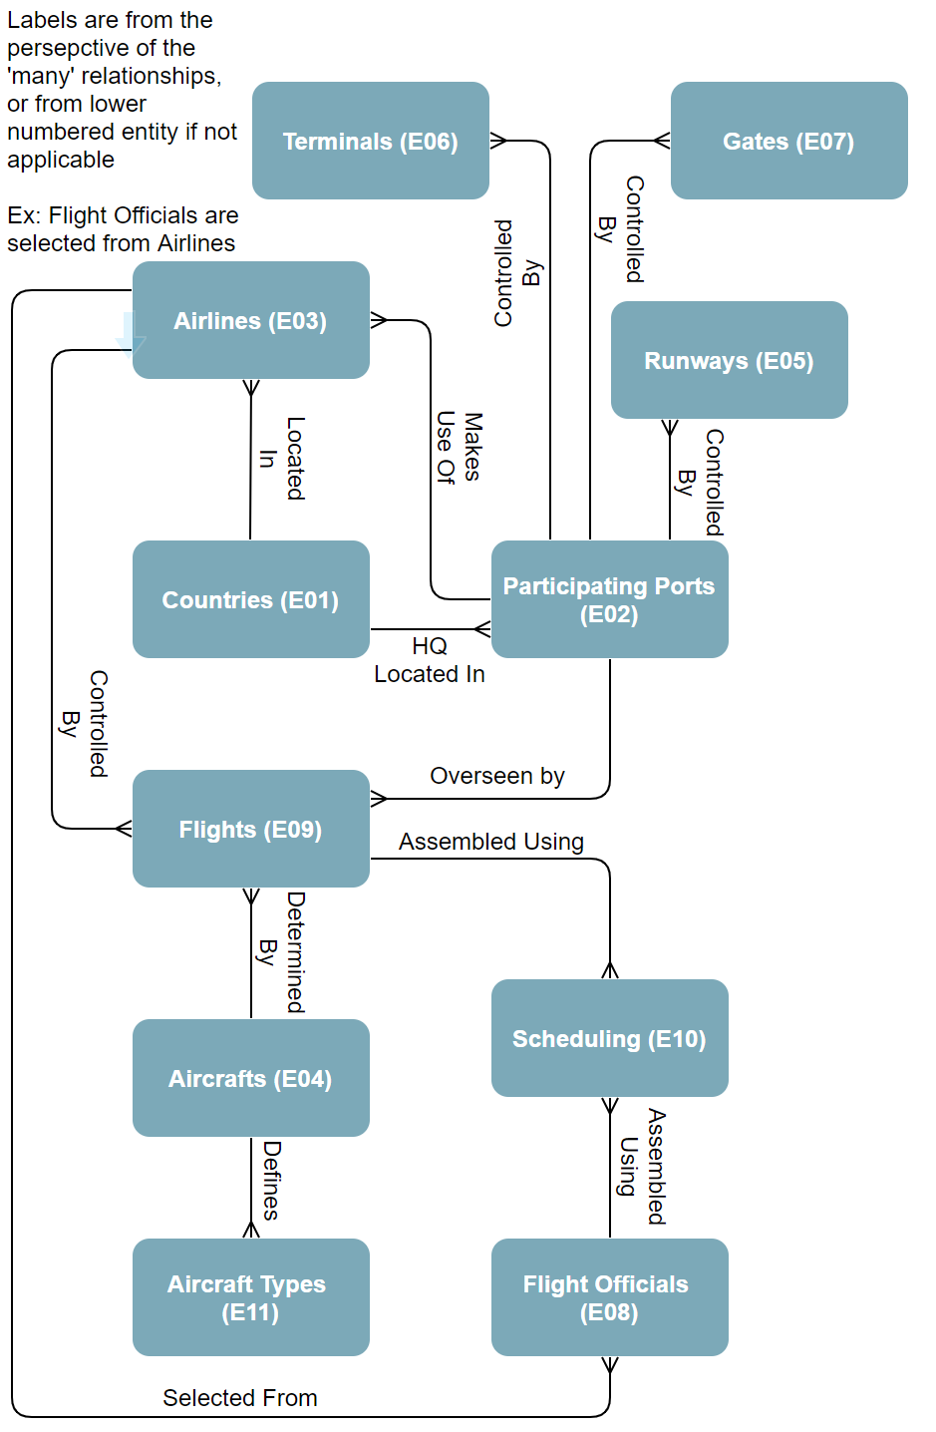
Entity Relationship Diagram (ERD)

Slide 9
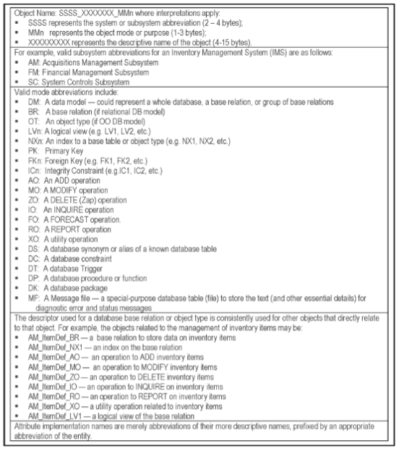
Storage List
Naming Conventions Used
We used this naming convention to start our comprehensive ESG. For this deliverable we omitted some specifics, to fit the project guidelines.
Foster, Elvis C. Software Engineering: A Methodical Approach pg. 207
Notes:
This is the naming convention that we used for our Storage List, here we will be listing all of the entities, small comments and attributes.

Slide 10
Countries (E01)
E01 – Countries [LAM_countries_BR]
Attributes: Country Code [ CnCode ] [ Char(3) ] Country Name [ CnName ] [ VarChar(100) ] Country Abbreviation [ CnAbbr ] [ VarChar(10) ]
Comments: Entity to keep track of all participating countries for LAM system, referenced by many other entities for location information. Country Code and Country Abbreviation are not necessarily the same and could be confused with each other. Consider Country Code as alphanumeric representation of country, whereas country abbreviation is just alphabetic. Country Name is NOT NULL. CnCode can either be straight numeric or alphanumeric, recommend alphanumeric for easier interpretation. Example: [ CnCode=’NA2’ ; CnAbbr=’USA’ ] representing United States.

Slide 11
Participating Ports (E02)
E02 – Participating Ports [LAM_participatingports_BR]
Attributes: Port Code [ PortCode ] [ Char(6) ] Port Full Name [ PortFullName ] [ VarChar(100) ] Port Name [ PortName ] [ VarChar(50) ] Port Country Code [ PortCnCode ] [ Char(3) ] {Refers E01.CnCode}
Comments: Entity to keep track of all participating ports across various countries, shorthand name ‘PortName’ added for convenience of query. PortFullName is NOT NULL.

Slide 12
Airlines (E03)
E03 – Airlines [LAM_airlines_BR]
Attributes: Airline ID Code [ AL_IDCode] [ Char(9) ] Airline Name [ AL_Name ] [ VarChar(100) ] Airline Callsign [ AL_Callsign] [VARCHAR(32)] Airline Host Country [ AL_CnCode ] [ Char(3) ] {Refers E01.CnCode} Airline Host Port [ AL_PortCode ] [ Char(6) ] {Refers E02.PortCode} Airline Primary Address [ AL_HQAddress1 ] [ VarChar(100) ] Airline Host City [ AL_HQCity ] [ VarChar(50) ] Airline Contact Phone [ AL_HQPhone ] [ Number/Decimal(11,0) ] Airline Contact Name [ AL_Contact ] [ VarChar(100) ]
Comments: Entity to keep track of all participating airlines, their hosting country/port, and contact information. Primary key is defined as ‘PPPPPPXXX’ where ‘P’ is the host port code, and ‘X’ is alphanumeric. AL_Name and AL_HQAddress1 and AL_HQPhone are NOT NULL.

Slide 13
Aircraft (E04)
E04 – Aircrafts [LAM_aircrafts_BR]
Attributes: Aircraft Code [ AC_Code ] [ Char(10) ] Aircraft Name [ AC_Name ] [ VarChar(100) ] Aircraft Description [ AC_Desc ] [ VarChar(500) ] Aircraft Capacity [ AC_NumSeats ] [ Number/Decimal(3,0) ] Aircraft FeatureList [ AC_FeatureList ] [ VarChar(MAX)/Text ] Aircraft Type ID [ AC_ATypeCode ] [ Char(3) ] {Refers E11.ATypeCode} Aircraft Host Airline [ AC_AL_IDCode ] [ Char(9) ] {Refers E03.AL_IDCode}
Comments: Entity to keep track of all aircraft as references of participating airlines with a corresponding recognizable aircraft type. Feature list could be a number of different data types including: File,VarChar,Text,Blob depending on preference of storage medium for this information; For maximum compatibility across all airlines, countries, and ports, as well as minimal digital storage requirements for database, recommend either VarChar with max length or Text type. Aircraft Name and capacity NOT NULL.

Slide 14
Runways (E05)
E05 – Runways [LAM_runways_BR]
Attributes: Runway Code[ RwCode ] [ Char(8) ] Runway Name [ RwName ] [ VarChar(100) ] Runway Length [ RwLength ] [ Number/Decimal(4,0) ] Runway Width [ RwWidth ] [Number/Decimal(4,0) ] Runway Host Port [ RwPortCode ] [ Char(6) ] {Refers E02.PortCode}
Comments: Entity to keep track of all runways as a reference of hosting port, with runway dimensions. Runway Code defined as ‘AAAAAANN’ where ‘A’ is a letter and ‘N’ is a number. Runway Name NOT NULL.

Slide 15
Terminals (E06)
E06 – Terminals [LAM_terminals_BR]
Attributes: Terminal Code [ TermCode] [ Char(8) ] Terminal Name [ TermName ] [ VarChar(100) ] Terminal Status [ TermStatus ] [ Char(1) ] Terminal Host Port [ TermPortCode ] [ Char(6) ] {Refers E02.PortCode}
Comments: Entity to keep track of all terminals and associated port, complete with terminal status. TermCode defined as ‘AAAAAANN’ where ‘A’ is an alphabet letter and ‘N’ is a number. TermStatus should be open(O), closed(C), delayed(D), or unknown(?). Terminal Name NOT NULL.

Slide 16
Gates (E07)
E07 – Gates [LAM_gates_BR]
Attributes: Gate Code [ GCode ] [ Char(8) ] Gate Name [ GName ] [ VarChar(100) ] Gate Status [ GStatus] [ Char(1) ] Gate Host Port [ GPortCode ] [ Char(6) ] {Refers E02.PortCode}
Comments: Entity to keep track of all gates including associated port and status. GCode is defined as ‘AAAAAANN’ where ‘A’ is an alphabet letter and ‘N’ is a number. GStatus should be open(O), closed(C), delayed(D), or unknown(?). Gate name NOT NULL.

Slide 17
Flight Officials (E08)
E08 – Flight Officials [LAM_flightofficials_BR]
Attributes: Flight Official ID Code [ FOffCode ] [ Char(6) ] Flight Official First Name [ FOffFName ] [ VarChar(50) ] Flight Official Middle Initial [ FOffMInitial ] [ VarChar(2) ] Flight Official Family Surname [ FOffLName ] [ VarChar(50) ] Flight Official Host Airline [ FOff_ALCode ] [ Char(9) ] {Refers E03.AL_IDCode}
Comments: Entity to keep track of all airline staff related to flights and which airline that employs them. FOffCode defined as ‘XXXXXX’ where ‘X’ is alphanumeric. All employees must have at least a first name and family surname to be valid.

Slide 18
Flights (E09)
E09 – Flights [LAM_flights_BR]
Attributes: Flight ID Number [ FlyCode ] [ Char(6) ] Flight Origin Port [ FlySrcPortCode ] [ Char(6) ] {Refers E02.PortCode} Flight Destination Port [ FlyDestPortCode ] [ Char(6) ] {Refers E02.PortCode} Flight Intermediate Port [ FlyInterPortCode ] [ Char(6) ] {Refers E02.PortCode} Flight Host Airline [ FlyALCode ] [ Char(9) ] {Refers E03.AL_IDCode} Flight Aircraft ID [ FlyAC_Code ] [ Char(10) ] {Refers E04.AC_Code}
Comments: Entity to keep track of all flights, and key stopping locations of the flight path. All flights will require flight officials and have at minimum two interacting ports of note. FlyCode defined as ‘XXXXXX’ where ‘X’ is alphanumeric.

Slide 19
Scheduling (E10)
E10 – Scheduling [LAM_scheduling_BR]
Attributes: Flight ID Number [ SchFlyCode] [ Char(6) ] {Refers E09.FlyCode} Flight Date [ SchDepartDate ] [ Number/Decimal(8,0) ] Flight Primary Pilot 1 [ SchFOff_P1 ] [ Char(6) ] {Refers E08.FOffCode} Flight Primary Pilot 2 [ SchFOff_P2 ] [ Char(6) ] {Refers E08.FOffCode} Flight Primary Crew Member 1 [ SchFOff_A1 ] [ Char(6) ] {Refers E08.FOffCode} Flight Primary Crew Member 2 [ SchFOff_A2 ] [ Char(6) ] {Refers E08.FOffCode} Flight Primary Crew Member 3 [ SchFOff_A3 ] [ Char(6) ] {Refers E08.FOffCode} Flight Secondary Crew Member 1 [ SchFOff_A4 ] [ Char(6) ] {Refers E08.FOffCode} Flight Secondary Crew Member 2 [ SchFOff_A5 ] [ Char(6) ] {Refers E08.FOffCode} Flight Secondary Crew Member 3 [ SchFOff_A6 ] [ Char(6) ] {Refers E08.FOffCode} Is Flight Departed [ SchFlightOut ] [ Number/equivalent type(1) ] Is Flight On Schedule [ SchFlightOnTime ] [ Number/equivalent type(1) ]
Comments: Entity to keep track of flight schedule and associated crew members for flights. All flights MUST HAVE 2 pilots and at minimum 3 assisting crew members to be considered launch-ready, all primary attributes must be filled. Primary Key is composite key of #1 and #2, the flight in question and the date of departure in that order. Date should be in the format yyyymmdd (year,month,day). SchFlightOut and SchFlightOnTime are effectively boolean flags, but it is easier and more cross-compatible to do a number with a length of 1 for this purpose, just flip between ‘0’ and ‘1’ for false and true respectively.

Slide 20
Aircraft Types (E11)
E11 – Aircraft Types [LAM_aircrafttypes_BR]
Attributes: Aircraft Type Code [ ATypeCode ] [ CHAR(3) ] Aircraft Type Description [ ATypeDesc] [ VarChar(MAX)/Text ] Aircraft Seating Capacity [ATypeSeating] [NUMBER(4)]
Comments: Entity to keep record of recognized aircraft types, from which E04-Aircrafts is derived. Various vehicle types are catalogued here to officially stamp them as approved aircrafts for international traveling and identify features of an aircraft type that may be beneficial for specific flight routes or use-cases. Example: Smaller aircraft types/classes may be better on fuel and hence better suited for longer distance travel to destination ports that don’t have as much demand from consumers as other ports.

Slide 21
Storage List
End of Storage List
Foster, Elvis C. Software Engineering: A Methodical Approach pg. 207

Slide 22
Operational Requirements
System will be implemented using MySQL/MariaDB with user interfaces implemented in a programming language to be determined
Separation of database & interface allows for better data validation, easier user experience
Provide a software interface for operations on each entity—entry, modification, deletion, querying—as well as “tiered” access to only authorized info
Offer advanced interfaces for complex tasks, such as assembling a roster of crew for a flight
Generate read-only logical views of arrival/departure board, work schedules, etc.
Notes:
Each data entry task needs validation & help within the software interface. Users can’t just be left without feedback. Software can provide more information beyond plain database tables.

Slide 23
Building useful software interfaces
Main concern of data entry: correctness. What we can do within software:
Authenticate/validate data according to known formats
Forbid entry of invalid or illogical data, mark bad fields for correction
Provide guidance to the user as to why their query is being rejected
Not just data entry: static public-facing views also needed
Render logical view of arrivals & departures to table format
Cache until data changes or update is prompted
How to build a software interface that works across large organizations
Notes:
Data validation provides fences to keep the users on track when using the software.

Slide 24
Referential & data integrity rules
Country Definitions
Country code and name must be non-blank and non-null
Country code must conform to international standards (ISO 3166-1 alpha-3), i.e. Great Britain is GBR.
Port Definitions
Port code & name must be non-blank, non-null
Port code must be drawn from international standards (ICAO or IATA), i.e. John F. Kennedy Int’l Airport is JFK.
Port’s Related Country must be drawn from E01
Airline Definitions
Airline code & name must be non-blank, non-null
Airline Identification Code must be drawn from international standards, e.g. American Airlines is AAL.
Airline’s Host Country must be drawn from E01
Airline’s Base Port must be drawn from E02
Callsign is drawn from standards, e.g. AAL is American.
Aircraft Definitions
Aircraft code & name must be non-blank, non-null
Aircraft’s Type Code must be drawn from E011
Airline’s Host Airline must be drawn from E03
Notes:
Country, airport, and airline records all use international standard codes for identification.

Slide 25
Referential & data integrity rules cont.
Runway Definitions
Runway code & name must be non-blank, non-null
Runway’s Port Code must be drawn from E02
Runway length and width shall be defined in meters
Terminal Definitions
Terminal code & name must be non-blank, non-null
Terminal’s Port Code must be drawn from E02
Gate Definitions
Gate code & name must be non-blank, non-null
Gate’s Port Code must be drawn from E02
Flight Officials Definitions
Flight Officials code & name must be non-blank, non-null
Flight Official’s Related Airline code must be drawn from E03
Flight Definitions
Flight code & name must be non-blank, non-null
Flight Source Port must be drawn from E02
Flight Destination Port must be drawn from E02
Flight Intermediary Port must be drawn from E02
Flight Source, Destination, & Intermediary Ports must not be duplicates
Flight’s Related Airline must be drawn from E03
Flights Related Aircraft must be drawn from E04

Slide 26
Referential & data integrity rules cont.
Arrival/Departure Schedule Definitions
Arrival/Departure Schedule code & name must be non-blank, non-null
Flight Number must be drawn from E09
Flight First Pilot must be drawn from E08
Flight Second Pilot must be drawn from E08
Flight Main Attendant must be drawn from E08
Flight Other Attendant 2 must be drawn from E08
Flight Other Attendant 3 must be drawn from E08
Flight Other Attendant 4 must be drawn from E08
Flight Other Attendant 5 must be drawn from E08
Flight Other Attendant 6 must be drawn from E08
Flight crew FKs must be unique per-flight, i.e. no duplicates within a single record
Flight crew FK referencing a specific employee cannot exist on two simultaneous flights
Aircraft Type Definitions
Aircraft Type code & name must be non-blank, non-null
Aircraft type code must be drawn from IATA lists, e.g. a Boeing 737-800 is 738.
Notes:
Aircraft type codes are from IATA standards

Slide 27
User operations list
E01 Countries
Add Countries [E01_A]
Delete Countries [E01_Z]
Inquire Countries [E01_I]
E02 Participating Ports
Add Participating Ports [E02_A]
Modify Participating Ports [E02_M]
Delete Participating Ports [E02_Z]
Inquire Participating Ports [E02_I]
Report Participating Ports [E02_P]
E03 Airline
Add Airline [E03_A]
Modify Airline [E03_M]
Delete Airline [E03_Z]
Inquire Airline [E03_I]
Report Airline [E03_P]
E04 Aircraft
Add Aircraft [E04_A]
Modify Aircraft [E04_M]
Delete Aircraft [E04_Z]
Inquire Aircraft [E04_I]
Report Aircraft [E04_P]
E05 Runway
Add Runway [E05_A]
Modify Runway [E05_M]
Delete Runway [E05_Z]
Inquire Runway [E05_I]
Report Runway [E05_P]
E06 Terminal
Add Terminal [E06_A]
Modify Terminal [E06_M]
Delete Terminal [E06_Z]
Inquire Terminal [E06_I]
Report Terminal [E06_P]
E07 Gate
Add Gate [E07_A]
Modify Gate [E07_M]
Delete Gate [E07_Z]
Inquire Gate [E07_I]
Report Gate [E07_P]
E08 Flight Officials
Add Flight Officials [E08_A]
Modify Flight Officials [E08_M]
Delete Flight Officials [E08_Z]
Inquire Flight Officials [E08_I]
Report Flight Officials [E08_P]
E09 Flight Definitions
Add Flight Definitions [E09_A]
Modify Flight Definitions [E09_M]
Delete Flight Definitions [E09_Z]
Inquire Flight Definitions [E09_I]
Report Flight Definitions [E09_P]
E10 Arrival/Departure Schedule
Add Arrival/Departure Schedule [E10_A]
Modify Arrival/Departure Schedule [E10_M]
Delete Arrival/Departure Schedule [E10_Z]
Inquire Arrival/Departure Schedule [E10_I]
Report Arrival/Departure Schedule [E10_P]
E11 Aircraft Types
Add Aircraft Types [E11_A]
Modify Aircraft Types [E11_M]
Delete Aircraft Types [E11_Z]
Inquire Aircraft Types [E11_I]
Report Aircraft Types [E11_P]
Notes:
Our list of operations provided per entity. This includes
Addition
Modification if supported
Deletion
Inquiries
Report generation when applicable

Slide 28
Procedural Rules
Port Information Subsystem
To be populated before all other subsystems
Information will be largely static & widely referenced across the FMS
Airline & Airport Subsystem
Populated with detailed information on all participating airlines & their respective aircraft
Flight Information Subsystem
Updated throughout each day with latest information
Will be changed the most rapidly, reflecting the current state of operations.
Filled after population of PIS
Notes:
Each subsystem is populated with data in a specific order, so as to maintain integrity. Port Information contains keys needed by Airline & Airport, and Flight information relies on both being populated.

Slide 29
Schedule of Logical Views
Descriptive Name | Summarized Specification
Port Connections | Joins Port Definition (E02) to Country Definition (E01)
Airline Connections | Joins Airline (E03) to Port (E02) and Country (E01)
Crew of Specific Flight | Joins Flight Crew (E08) with Flights (E09) and Scheduling (E10)
Crew Schedule | Joins Flight Crew (E08) with Scheduling (E10)
Airframe Schedule | Joins Aircraft (E04) with Aircraft Type (E11), Flights (E09), and Scheduling (E10)
Arrival/Departure Board | Joins Flights (E09), Scheduling (E10), Airline (E03), Port (E02), Terminal (E06), and Gate (E07)
Per-Gate Schedule | Joins Flights (E09) with Scheduling (E10), Airline (E03), and Gate (E07)
Delays & Cancellations | Arrival/Departure board with added selection of only cancelled or delayed flights.
Airline Fleet | Joins Airline (E03) with Aircraft (E04) and Aircraft Type (E11)
Airport Infrastructure Report | Joins Port (E02) with Country (E01), Runway (E05), Terminal (E06), Gate (E07)
Predefined views for frequently-used data combinations
Notes:
Our currently planned list of logical views for inclusion in the database, to be revised & expanded as needed. These will offer ready-made combinations of data as needed for decision-making. Since logical views take up no actual space, they can be added, removed, and modified as needed to suit the users’ needs.

Slide 30
System Security
Varied access levels depending on job responsibility, following the principle of least privilege and only granting what is required to carry out a job
Administrator granted highest level of access to all subsystems, high bar to gain this level as they have the greatest ability to mangle the database.
Scheduler granted rights to add and modify only flight schedule records, view relevant records to be referenced per-flight (aircraft, airlines, ports, crew).
Department management given control over only their relevant subsystem and its records, ability to add, modify and delete records as necessary.
Notes:
Our security approach uses “groups” of user accounts with varying levels of access and privileges. We follow the principle of least privilege, which says that users and software should only be given access to the data specifically needed for their assigned job, and nothing beyond that.

Slide 31
Revised Project Schedule
Activity # | Activity Description | Weeks
A | Initial System Requirement | 1
B | Requirements Specification | 2
C | Design Specification | 3
D | Database Creation | 3
E | Prototype Development | 10
F | Software Documentation | 3
G | Software Install/Delivery/Training | 2
H | Initial Maintenance | 1
 | Total duration | 25
Assumption: This will be a project team of three software engineers
Notes:
Our revision only adds a week of initial maintenance time, and still projects our product delivery as taking 24 weeks. “Initial maintenance” merely accounts for the bugs and errors which arise once a product is fully launched to a production environment.

Slide 32
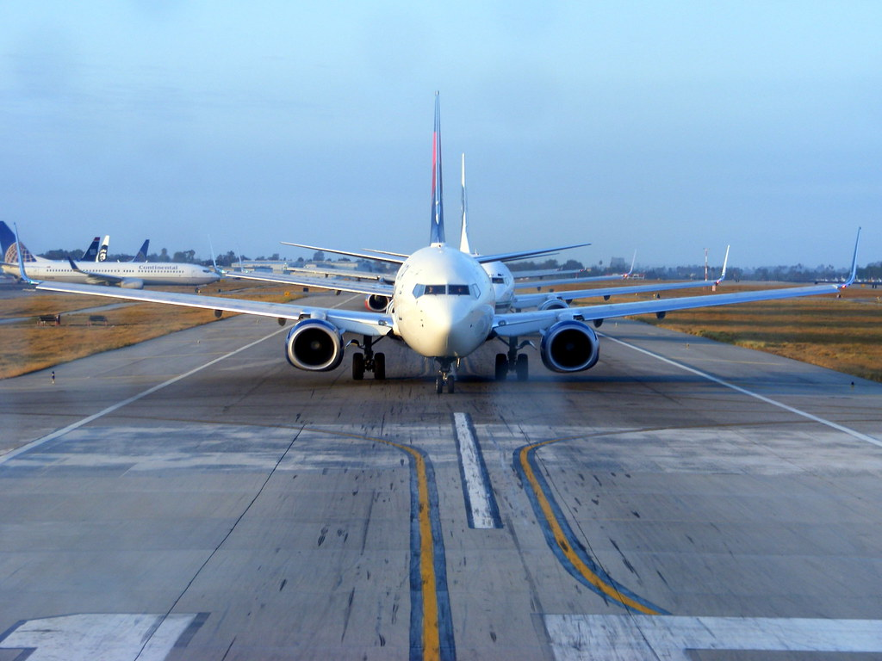
Conclusion
Requirements of our software system have been elaborated
This document will serve as a reference for future design and implementation of the FMS
Further details will be provided by the upcoming design specification
The FMS will be designed with flexibility in mind to service all airlines and ports

Slide 33
References
Foster, Elvis C. Software Engineering: A Methodical Approach. Second Edition. CRC Press. 2022
One World – Nations Online Project. Country Codes List. Copyright 1998-2022 nationsonline.org
International tourism, number of arrivals | Data. (2020). [Data Polling]. The World Bank. https://data.worldbank.org/indicator/ST.INT.ARVL
Air Traffic Organization. Directive No. JO 7340.2F with Change 1 and Change 2 and Change 3. Federal Aviation Administration. 2015.

